Slide 1
Applied Physics NS (101)
LECTURE # 12&13
DATE: 17^{TH &} 20TH SEPTEMBER , 2019

Slide 2
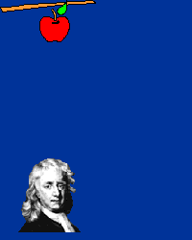
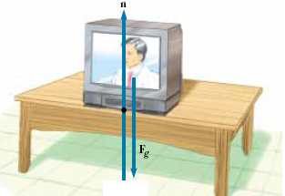
Laws of Motion
What happens when several forces act simultaneously on an object?
The object accelerates only if the net force(total/resultant/unbalance), acting
on it is not equal to zero.
If the net force exerted on an object is
zero, then the acceleration of the object is
zero and its velocity remains constant.
The object is said to be in equilibrium.

Slide 3

Newton’s First Law
An object at rest will stay at rest, and an object in motion will stay in motion at constant velocity, unless acted upon by an unbalanced force.
Once airborne, unless acted on by an unbalanced force (gravity and air – fluid friction), it would never stop!
Unless acted upon by an unbalanced force, this golf ball would sit on the tee forever.

Slide 4
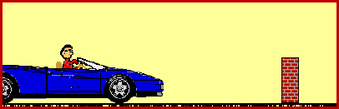
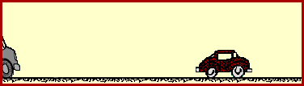
Inertia
The tendency of an object to resist any attempt to change its velocity is called the inertia of the object.
Don’t let this be you. Wear seat belts.
Because of inertia, objects (including you) resist changes in their motion. When the car going 80 km/hour is stopped by the brick wall, your body keeps moving at 80 m/hour.

Slide 5

Mass:
Mass is that property of an object that specifies how much inertia the object has.
The greater the mass of an object, the less that object accelerates under the action of an applied force.
Mass is an inherent property of an object and is independent of the object’s
surroundings and of the method used to measure it.
Mass is a scalar quantity.
Weight :
The weight of an object is equal to the magnitude of the gravitational force exerted on the object and varies with location.
F =mg
For example, a person who weighs 180 lb on the Earth weighs only about 30 lb on the
Moon.
On the other hand, the mass of a body is the same everywhere: an object having
a mass of 2 kg on the Earth also has a mass of 2 kg on the Moon.
Weight is a vector quantity .

Slide 6
What causes “weightlessness”?
Even in the space shuttle, there is a force of attraction exerted by the earth on the shuttle and its contents.
When the space shuttle temporarily “falls” toward the earth, the contents of the space shuttle appear to be weightless, but in fact they are falling with the space shuttle. This is called “freefall”.

Slide 7

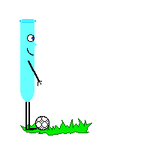

Newton’s Second Law
The acceleration of an object is directly proportional to the net force acting on it and inversely proportional to its mass.
When mass is in kilograms and acceleration is in m/s/s, the unit of force is in Newtons (N).
One Newton is equal to the force required to accelerate one kilogram of mass at one meter/second/second

Slide 8
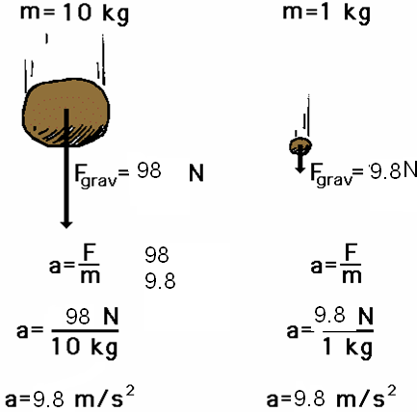
Newton’s 2nd Law proves that different masses accelerate to the earth at the same rate, but with different forces.
We know that objects with different masses accelerate to the ground at the same rate.
However, because of the 2nd Law we know that they don’t hit the ground with the same force.
F = ma
98 N = 10 kg x 9.8 m/s/s
F = ma
9.8 N = 1 kg x 9.8 m/s/s

Slide 9


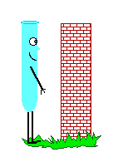
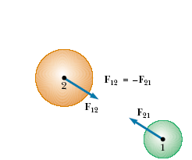
Newton’s Third Law
For every action, there is an equal and opposite reaction.

Slide 10

Newton’s 3rd Law in Nature
Consider the propulsion of a fish through the water. A fish uses its fins to push water backwards. In turn, the water reacts by pushing the fish forwards, propelling the fish through the water.
The size of the force on the water equals the size of the force on the fish; the direction of the force on the water (backwards) is opposite the direction of the force on the fish (forwards).

Slide 11

3rd Law
Flying gracefully through the air, birds depend on Newton’s third law of motion. As the birds push down on the air with their wings, the air pushes their wings up and gives them lift.

Slide 12

Consider the flying motion of birds. A bird flies by use of its wings. The wings of a bird push air downwards. In turn, the air reacts by pushing the bird upwards.
The size of the force on the air equals the size of the force on the bird; the direction of the force on the air (downwards) is opposite the direction of the force on the bird (upwards).
Action-reaction force pairs make it possible for birds to fly.

Slide 13
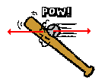

Other examples of Newton’s Third Law
The baseball forces the bat to the left (an action); the bat forces the ball to the right (the reaction).

Slide 14

3rd Law
The reaction of a rocket is an application of the third law of motion. Various fuels are burned in the engine, producing hot gases.
The hot gases push against the inside tube of the rocket and escape out the bottom of the tube. As the gases move downward, the rocket moves in the opposite direction.

Slide 15
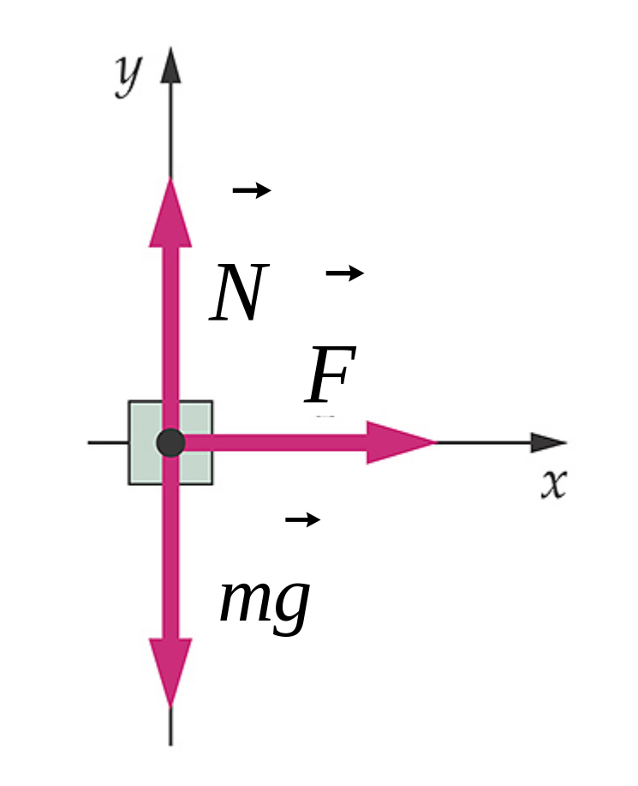
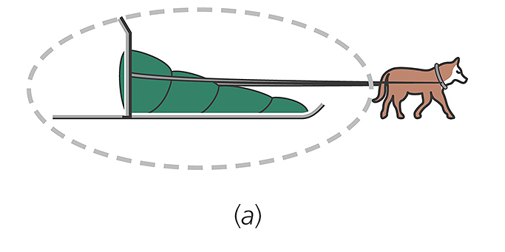
Free Body Diagram

Slide 16
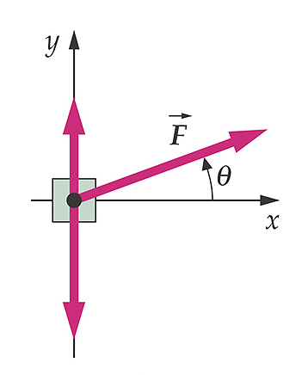
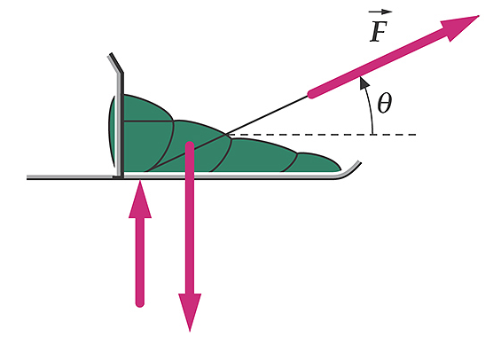
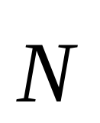
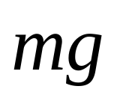
Same problem but the applied force is angled up

Slide 17
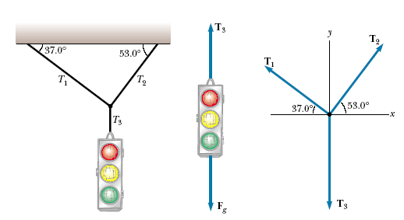



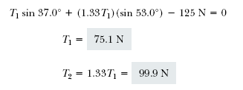

APPLICATIONS OF NEWTON’S LAWS
A Traffic Light at Rest

Slide 18
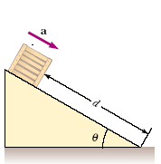



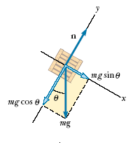
Crate on a Frictionless Incline

Slide 19
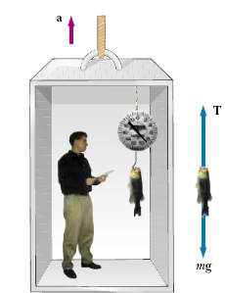
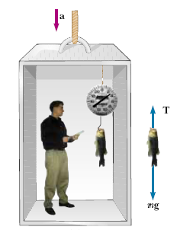

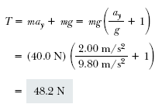

Weighing a Fish in an Elevator
A person weighs a fish of mass m on a spring scale attached to
the ceiling of an elevator, as illustrated in Figure. Show that if the elevator accelerates either upward or downward, the spring scale gives a reading that is different from the weight of the fish.
If the elevator is either at rest or moving at constant velocity, the fish is not accelerating, and so or (remember that the scalar mg
is the weight of the fish).T = mg
If the elevator moves upward with an acceleration a relative to an observer standing outside the elevator in an inertial frame.
The scale reading T is greater than the weight mg if a is upward, so that ay is positive, and that the reading is less than mg if a is downward, so that ay is negative.

Slide 20
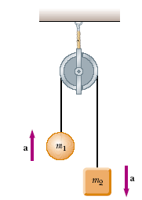

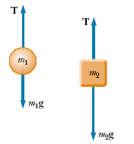



Atwood’s Machine
When two objects of unequal mass are hung vertically over a
frictionless pulley of negligible mass, Determine the magnitude of the acceleration of the two objects and the tension in the lightweight
cord.

Slide 21

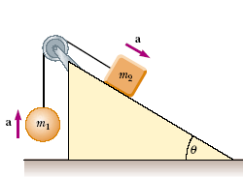



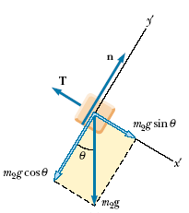

Acceleration of Two Objects Connected by a Cord
A ball of mass m1 and a block of mass m2 are attached by a lightweight cord that passes over a frictionless pulley of negligible mass, as shown in Figure. The block lies on a frictionless incline of angle . Find the magnitude of the acceleration of the two objects and the tension in the cord.

